Slide 1

GPU-accelerated
Cardiac Electrophysiological Simulation
Milestone III
Zirui Zang (zzang@seas.upenn.edu) 20211117

Slide 2
Simulation Demo

Slide 3
Project Progress
Preprocessed Data
Data Handler
Compute Kernels
Visualizer
Deployment & Testing
Finished:
Compiling and testing on Linux and Nvidia Jetson
Potential:
Optimize for Jetson runtime

Slide 4
Speed Comparison
 | Matlab | C++ Eigen | GPU Win10 | GPU Linux | GPU Linux float
time(s) | 140 | 37 | 2.0 | 0.66 | 0.5
speed vs. | 1x | 3.8x (1x) | 70x (18.5x) | 212x (56x) | 280x (74x)
Interesting finding: Same code compiled on Linux runs 3x faster. (Code is compiled in release mode on Windows)
CPU: Ryzen 3700x, GPU: RTX2070s

Slide 5
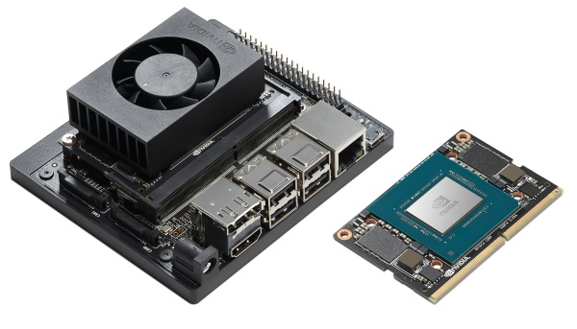
Testing on Other Platforms
Tested the simulator in three different platforms:
Server platform w/ RTX A6000 GPU (x64 Linux compile)
Workstation platform w/ RTX 2070s GPU (x64 Windows compile)
Embedded platform w/ Nvidia Jetson Xavier NX (Arm Linux compile)
 | Server (float) | Workstation (float) | Jetson (float)
time(s) | 0.5 (0.5) | 0.66 (0.5) | 7 (6)
* Code is dockerized and compiled on server.

Slide 6
Further Plan
With the new tool, we are planning to extend the project to create an auto-tuner for patient specific cardiac modeling. Expected to publish early next year.
We have also cooperated with cardiac modeling experts in the biology field and can add more models to this framework.

